Slide 1
Airport Parking Spot Tracker
Atlanta Govathon 2013

Slide 2
Project Team
Julian Knight cknight7@gatech.edu
Jon Pokrzyk jpokrzyk@gmail.com
Dimitri Tarassenko dtarassenko@gmail.com
Doug Strachan (Atlanta Airport)

Slide 3
Problem
In peak hours, it is difficult to find an available parking spot without driving right up to it. Driving around parking decks is wasteful (and not fun).
Requirements for the solution:
under $100 per parking spot, installed
no new conduit
battery life of min. 1 year

Slide 4
Problem, Restated as User Stories
As someone trying to find a parking spot...
...I’d like to see the available spots on my phone app
...I’d like to see the zones with available spots listed when I enter the lot / level
...I’d like to see if there is an available spot in the aisle while driving past the aisle (not down the aisle)

Slide 5
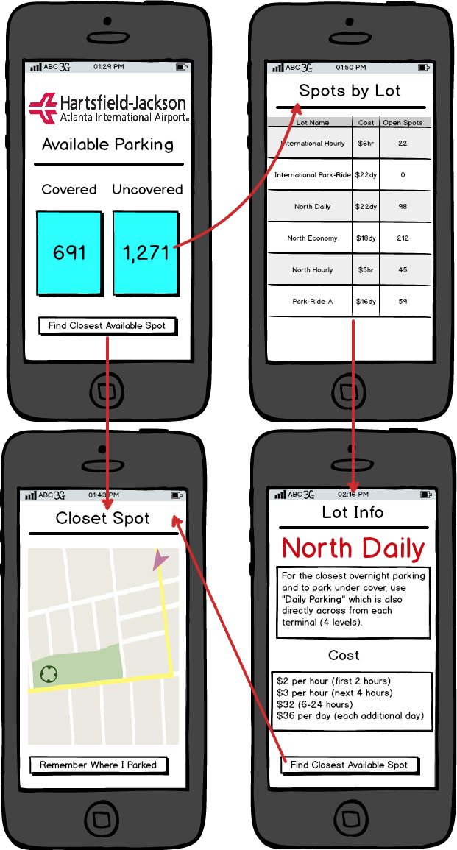
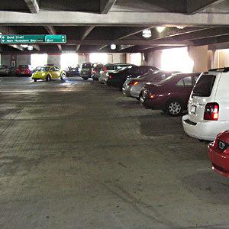
UX / User eXperience
App
Entering
Driving
L3: 320 FREE T1 T3 R5 Q1
L2: 20 FREE K2 K3 M15 L1: * F U L L *
at the entry, the signage displays “zones” with available parking spots
ceiling-mounted green light flashes arrow projected on the floor flashes

Slide 6

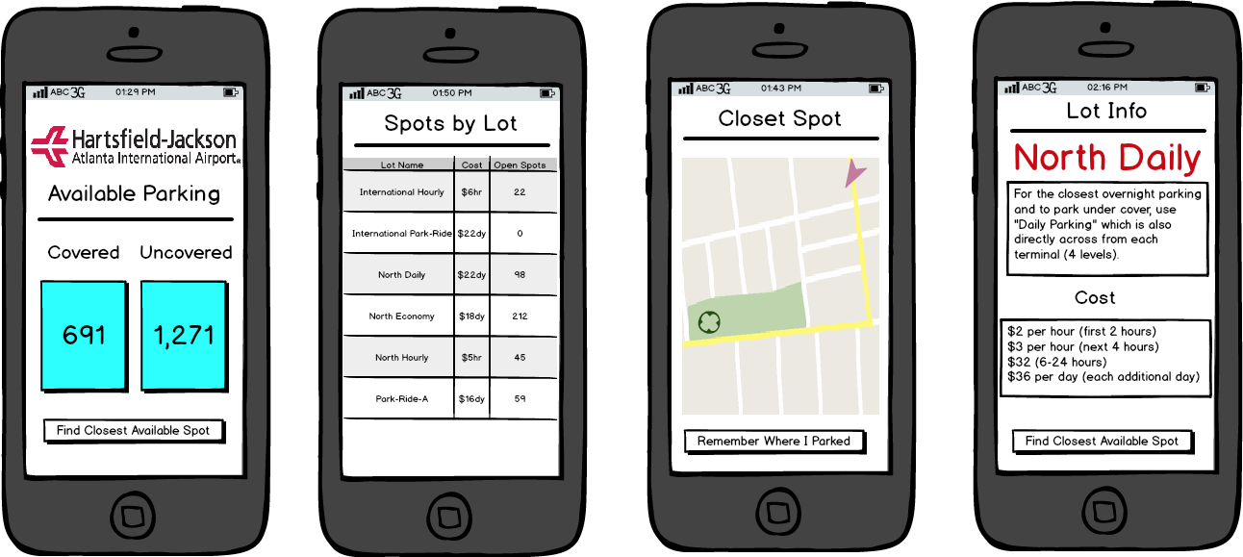
App

Slide 7
“Lean” Solutions to Tough Problems
Do more with less
[Re]use what’s already there

Slide 8
How Can We Do More With Less?
We can track several spots with one device:

Slide 9
How Can We Do More With Less?
When at least 1 spot is available, we will flash the light / project a flashing arrow on the floor

Slide 10
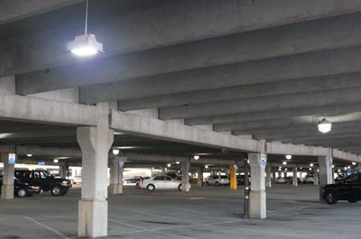
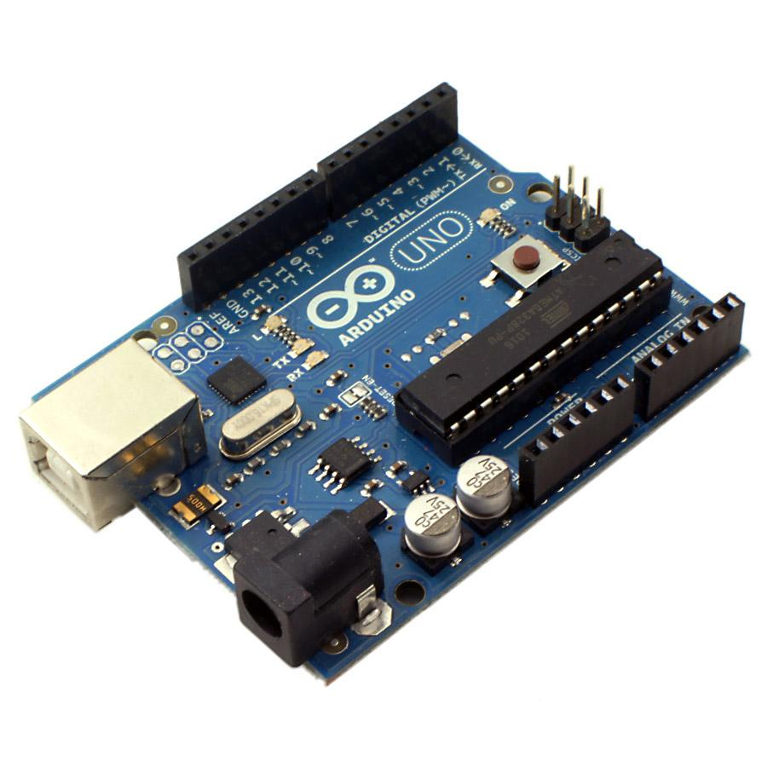
What’s Already There?
Lights! 4,000+ of them (and A/C power lines)
Open Source microcontrollers (Arduino)

Slide 11
Lights and A/C Wiring
the tracker is attached to the light fixture
available A/C power is used to drive the tracker and the signal lights
A/C wiring is used to network the trackers (Ethernet-over-Power - EoP)

Slide 12
Open Source Microcontrollers
Arduino/ATmega328 microcontroller
6 x ultrasonic range finders (proximity sensors)
relay for signal light
Arduino Ethernet “Shield” (NIC)

Slide 13
Other “Stuff”
Power supply
Signal Light (LED flashlight + color lens)
Adjustable mounts for sensors
Housing
EoP (Ethernet over Power) Module

Slide 14
What’s Not There? (To Be Built)
tracker device assembly
open source SCADA (supervisory control and data acquisition) server to collect tracker data (and may be control them)
web front-end / mobile app for drivers
facility management system interface for airport maintenance

Slide 15
Spot Tracker
AC Main
EoP
ENVIRONMENT
Light Fixture
SCADA Server
TRACKER
AC Power
EoP
Power Supply
Ethernet Over Power (EoP) Module
Range Finders
9V DC
Ethernet
1
2
Arduino Microcontroller
+Ethernet
...
Analog inputs
9V DC
DO
6
Relay
Signal Light

Slide 16
Bill of Materials / Prototype
Arduino Uno Ethernet $65 *RETAIL PRICING*
6 Proximity Sensors $25@ $150
Power Supply $10
EoP Module $20
Signal Light + Relay $30
Housing, Bolts&Nuts, Wiring $10
Installation, 2 man/hr @$50 $100
=====
$385
Divided by 6 parking spots: $64.15 per spot

Slide 17

But Wait! There is More!
just add a light sensor, and we can tell if the light fixture is out!

